Slide 1
Designing for Your Future Self
How Universal Design Shapes Better Products

Slide 2
Part 1
Basics

Slide 3
What the heck is „Universal Design”?

Slide 4
”
Universal Design
The design of products, environments, programmes and services to be usable by all people, to the greatest extent possible, without the need for adaptation or specialized design. “Universal design” shall not exclude assistive devices for groups of persons with disabilities where this is needed.
Convention on the Rights of Persons with Disabilities, Article 2

Slide 5
Universal Design - Principles
https://universaldesign.ie/about-universal-design/the-7-principles

Slide 6
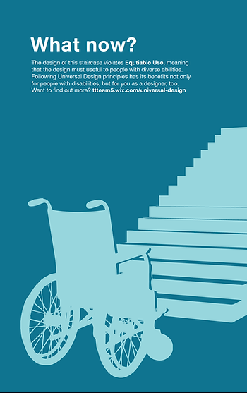
Principle 1
Equitable Use
The design is useful and marketable to people with diverse abilities.
https://ttteam5.wixsite.com/universal-design/equitable-use

Slide 7
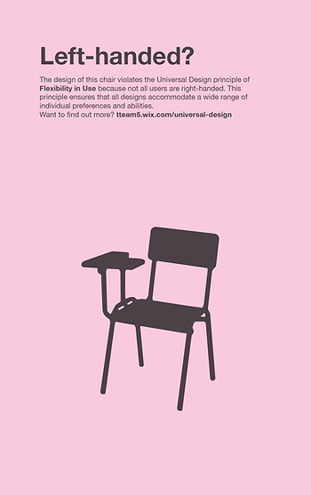
Principle 2
Flexibility in Use
The design accommodates a wide range of individual preferences and abilities.
https://ttteam5.wixsite.com/universal-design/flexibility-in-use

Slide 8
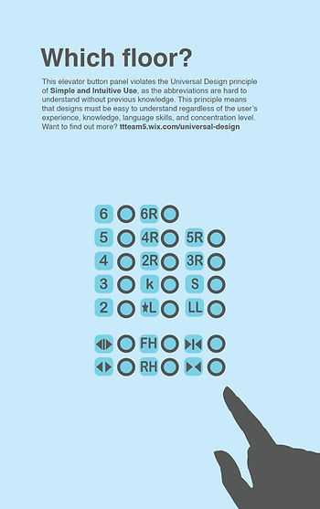
Principle 3
Simple and Intuitive Use
Use of the design is easy to understand, regardless of the user's experience, knowledge, language skills, or current concentration level.
https://ttteam5.wixsite.com/universal-design/simple--intuitive-use

Slide 9
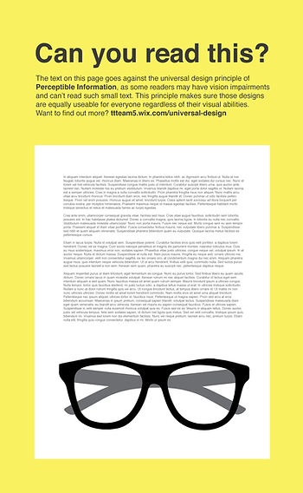
Principle 4
Perceptible Information
The design communicates necessary information effectively to the user, regardless of ambient conditions or the user's sensory abilities.
https://ttteam5.wixsite.com/universal-design/perceptible-information

Slide 10

Principle 5
Tolerance for Error
The design minimizes hazards and the adverse consequences of accidental or unintended actions.
https://ttteam5.wixsite.com/universal-design/tolerance-for-error

Slide 11
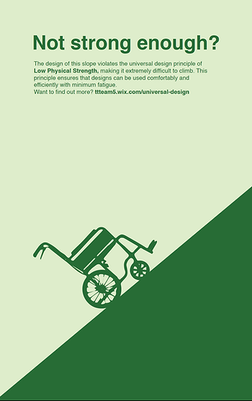
Principle 6
Low Physical Effort
The design can be used efficiently and comfortably and with a minimum of fatigue.
https://ttteam5.wixsite.com/universal-design/low-physical-effort

Slide 12
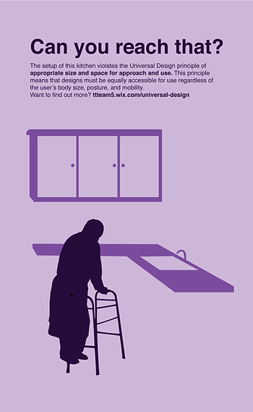
Principle 7
Size and Space for Approach and Use
Appropriate size and space is provided for approach, reach, manipulation, and use regardless of user's body size, posture, or mobility.
https://ttteam5.wixsite.com/universal-design/size-and-space-for-approach-and-use

Slide 13
BTW there is also „Inclusive Design”

Slide 14
”
Inclusive Design
Inclusive design describes methodologies to create products that understand and enable people of all backgrounds and abilities. It may address accessibility, age, economic situation, geographic location, language, race, and more.
Norman Nielsen | https://www.nngroup.com/articles/inclusive-design/

Slide 15
Universal Design - Principles
https://inclusivedesignprinciples.info/

Slide 16
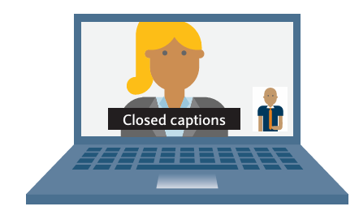
Provide comparable experience
Ensure your interface provides a comparable experience for all so people can accomplish tasks in a way that suits their needs without undermining the quality of the content.

Slide 17
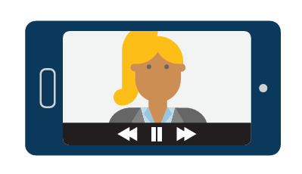

Give control
Ensure people are in control. People should be able to access and interact with content in their preferred way.

Slide 18
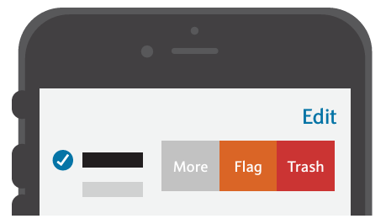
Offer choice
Consider providing different ways for people to complete tasks, especially those that are complex or non standard.

Slide 19
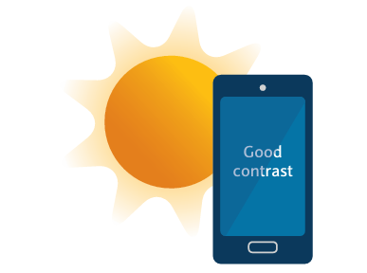
Consider situation
People use your interface in different situations. Make sure your interface delivers a valuable experience to people regardless of their circumstances.

Slide 20

Prioritise content
Help users focus on core tasks, features, and information by prioritising them within the content and layout.

Slide 21
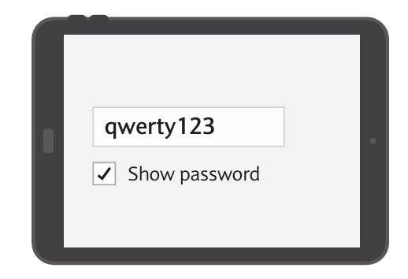

Add value
Consider the value of features and how they improve the experience for different users.

Slide 22
Universal vs Inclusive Design

Slide 23

Universal Design

Slide 24
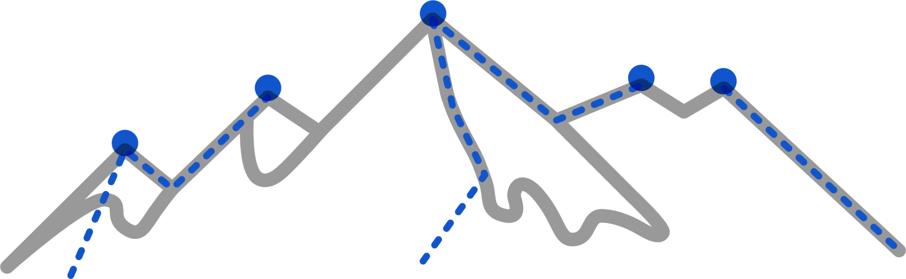
Inclusive Design

Slide 25
But the most important thing is the goal...

Slide 26
Inclusive design
Universal design
Accessibility
WCAG
EAA (2025)
ADA

Slide 27
What is accessibility?

Slide 28
”
Accessibility is the practice of designing products, services, environments, and digital content in a way that makes them usable by as many people as possible. It involves removing barriers that might prevent interaction, understanding, or access for individuals with physical, sensory, cognitive, or other types of disabilities.

Slide 29
Accessibility
(a11y)
…is a ”verb”

Slide 30
Accessibility
(a11y)
…is action

Slide 31
Accessibility
(a11y)
…it's the right of every person

Slide 32
Accessibility
(a11y)
...it's a process, not a single product or website

Slide 33
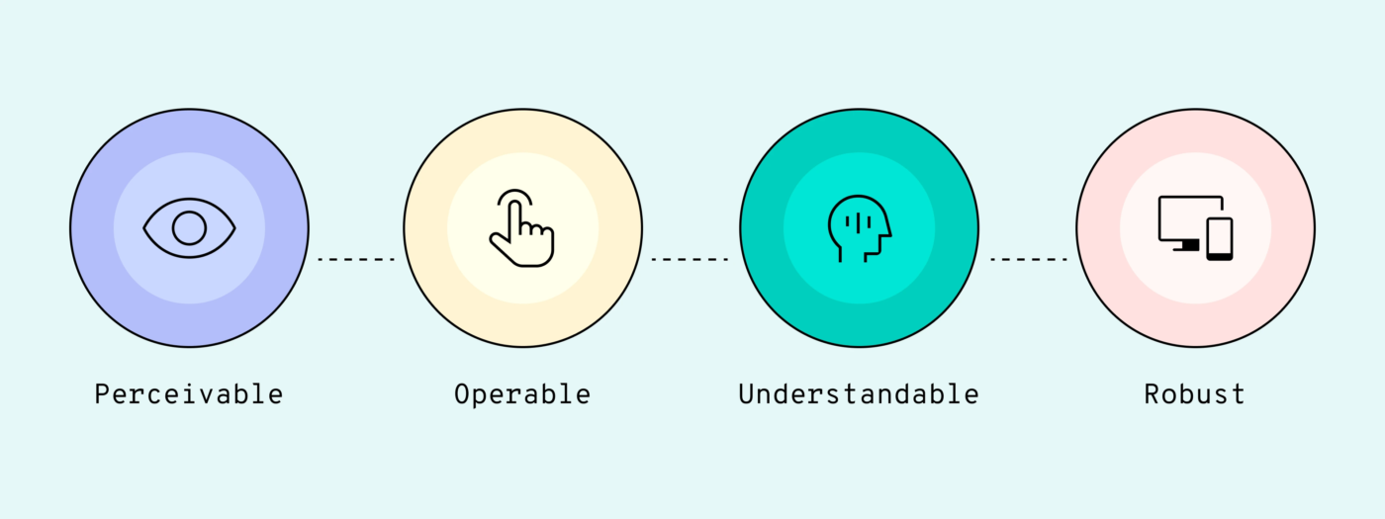
https://bb.agency/blog/accessibility-in-design-systems/

Slide 34
Perceivability
Ensuring information and UI elements are presented in ways users can perceive (e.g., providing text alternatives for images, captions for videos).

Slide 35
Operability
Making sure users can interact with the interface using various methods, such as keyboard-only navigation for users who cannot use a mouse.

Slide 36
Understandability
Designing content that is clear and intuitive, accommodating cognitive and learning disabilities.

Slide 37
Robustness
Ensuring content works with various assistive technologies, such as screen readers or alternative input devices.

Slide 38
Best practises

Slide 39
WCAG
Web Content Accessibility Guidelines are a set of standards designed to make web content more accessible to people with disabilities. These guidelines help ensure that websites are usable by everyone, regardless of their abilities or limitations, through better design and functionality.

Slide 40
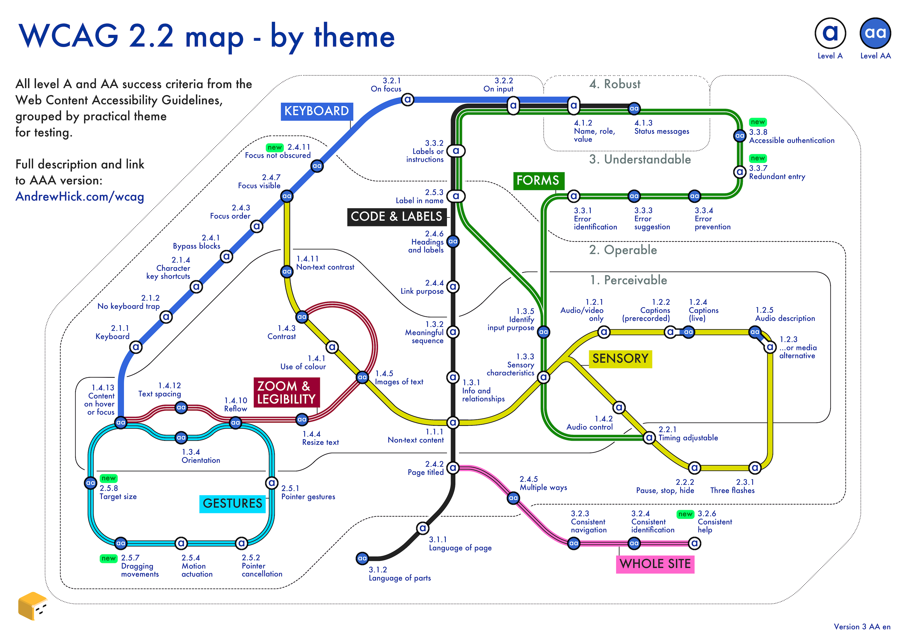
https://www.andrewhick.com/accessibility/wcag-map/

Slide 41
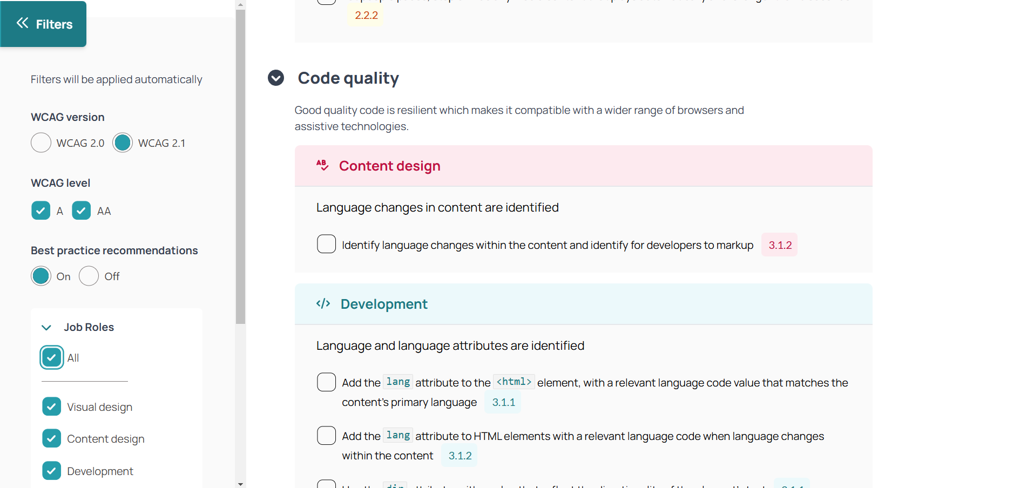
https://not-checklist.intopia.digital/

Slide 42
EN 301 549 V3.2.1
European standard that defines accessibility requirements for ICT products and services, including digital content, software, hardware, and public procurement. It ensures that both digital and physical technologies, such as websites, apps, kiosks, and terminals, are accessible to people with disabilities, promoting inclusivity across various platforms and environments.

Slide 43
Part 2
Awareness

Slide 44
Disability – how to understand it

Slide 45
Close your eyes
What do you see when you hear the word "disability"?

Slide 46
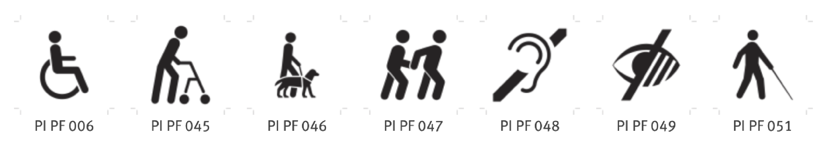
www.iso.org/obp

Slide 47

Disability as a Personal Attribute
Disability, a limitation or lack of ability to perform activities in a manner or range considered normal for a human being, resulting from impairment and dysfunction of the body.
World Health Organization 1980

Slide 48
20%
of the global population
Around 1.6 bilion people…

Slide 49
But… consider whether you have ever:

Slide 50
had to ask someone to repeat something because you didn’t hear it clearly

Slide 51
been so upset by something that you couldn’t focus on anything

Slide 52
experienced a situation where the sound on your computer wasn’t working (e.g., “Hey Andrew, we can see you, but we can’t hear you…”)

Slide 53
had your hands full and struggled to get through non-automatic doors

Slide 54
lost all enjoyment of supposedly good food in a restaurant because of a terrible cold

Slide 55
struggled with a form that was either incomprehensible or full of errors preventing you from completing it and obtaining what you needed

Slide 56
been unable (for any reason: not enough money, too tall, too short, too well-dressed, too casually dressed, too young, too old...) to do something you really wanted to do

Slide 57
You have experienced a ”mismatch”

Slide 58
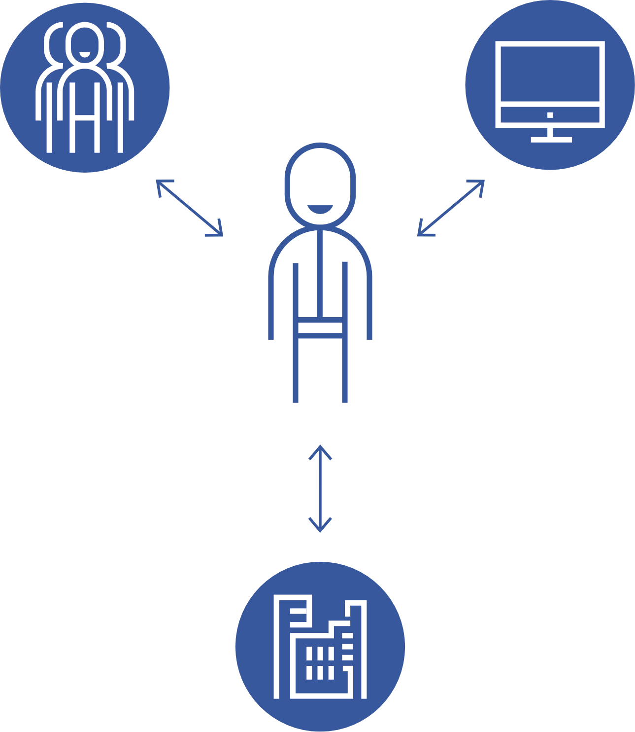
Context-Dependent Disability
The Social Model of Disability. Disability is a mismatched interaction between a person’s bodily characteristics and the features of the environment they live in.
World Health Organization 2011 | Mike Oliver, 1983

Slide 59
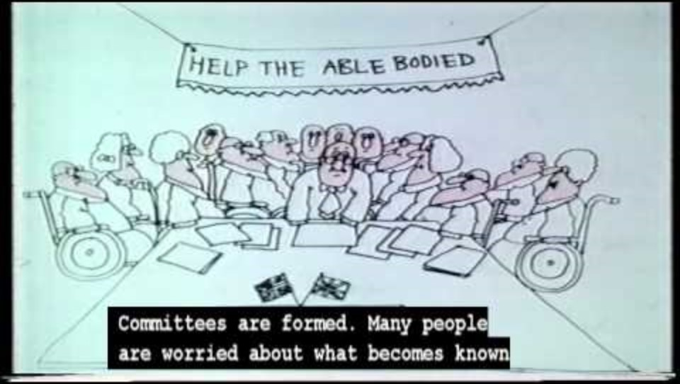
https://youtu.be/9s3NZaLhcc4?si=QX_vF0GbzD-601fi

Slide 60
78%
of clients can suffer because of a mismatch
According to the a research study conducted by Forrester Research for Microsoft in 2003

Slide 61
Built awareness

Slide 62
discover
define
develop
deliver

Slide 63
Who are we not talking to?
What did we fail to communicate
discover
define
develop
deliver
Who are we not including?
What needs did we NOT understand

Slide 64
Talk with people and learn from them…

Slide 65

https://github.com/UKHomeOffice/posters/blob/master/accessibility/researching-access-needs/Research-who_to_include_when%3F.pdf

Slide 66
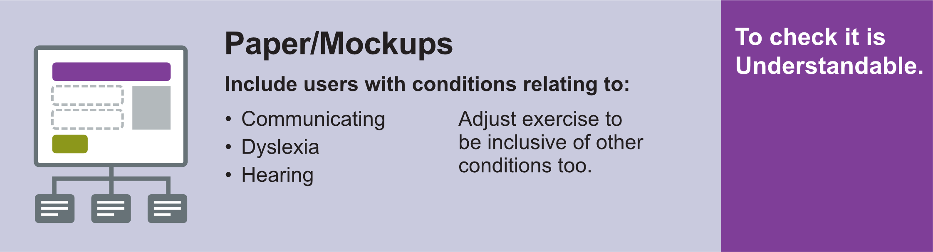
https://github.com/UKHomeOffice/posters/blob/master/accessibility/researching-access-needs/Research-who_to_include_when%3F.pdf

Slide 67
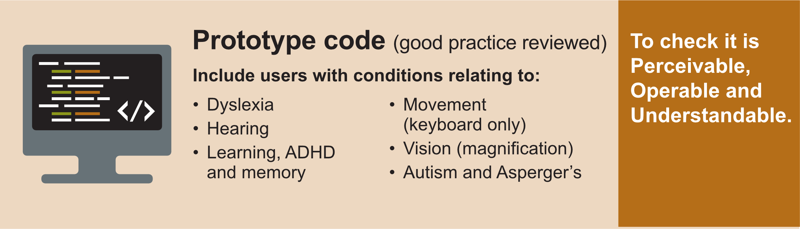
https://github.com/UKHomeOffice/posters/blob/master/accessibility/researching-access-needs/Research-who_to_include_when%3F.pdf

Slide 68
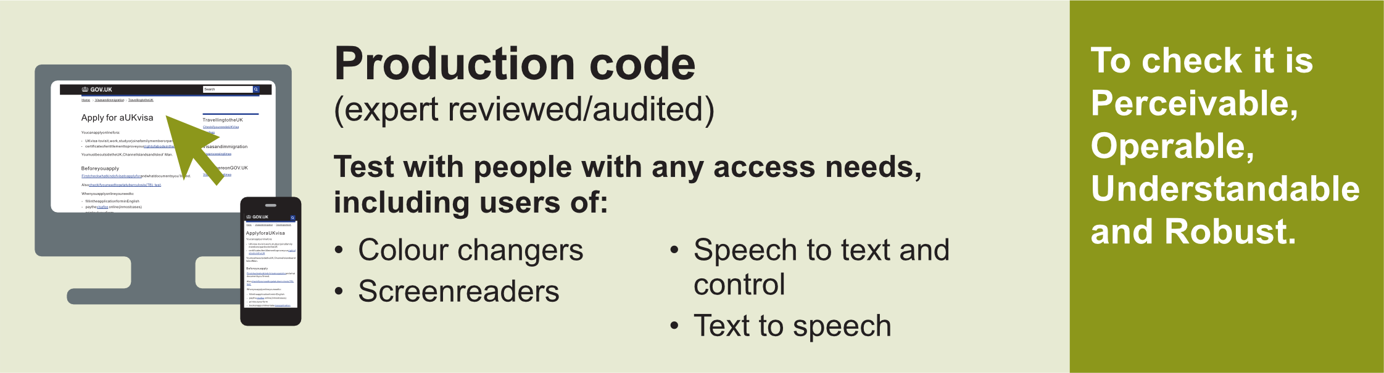
https://github.com/UKHomeOffice/posters/blob/master/accessibility/researching-access-needs/Research-who_to_include_when%3F.pdf

Slide 69
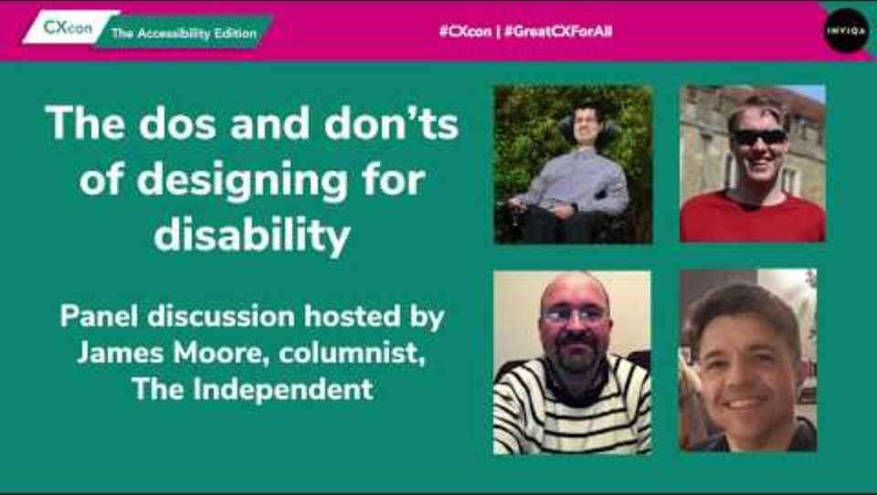

Slide 70
Harm your designs and concepts, not people

Slide 71
Inclusive Design Canvas
(Persona Permutation)
Persona permutation enables the discovery of potential exclusions and the generation of ideas to address them.

Slide 72






Gender identity
Physical condition Mental state
Age
what happens when something changes...
Technology Environment Circumstances
Personal life
Professional life
Original persona
Knowledge
Skills
Qualifications

Slide 73


Slide 74
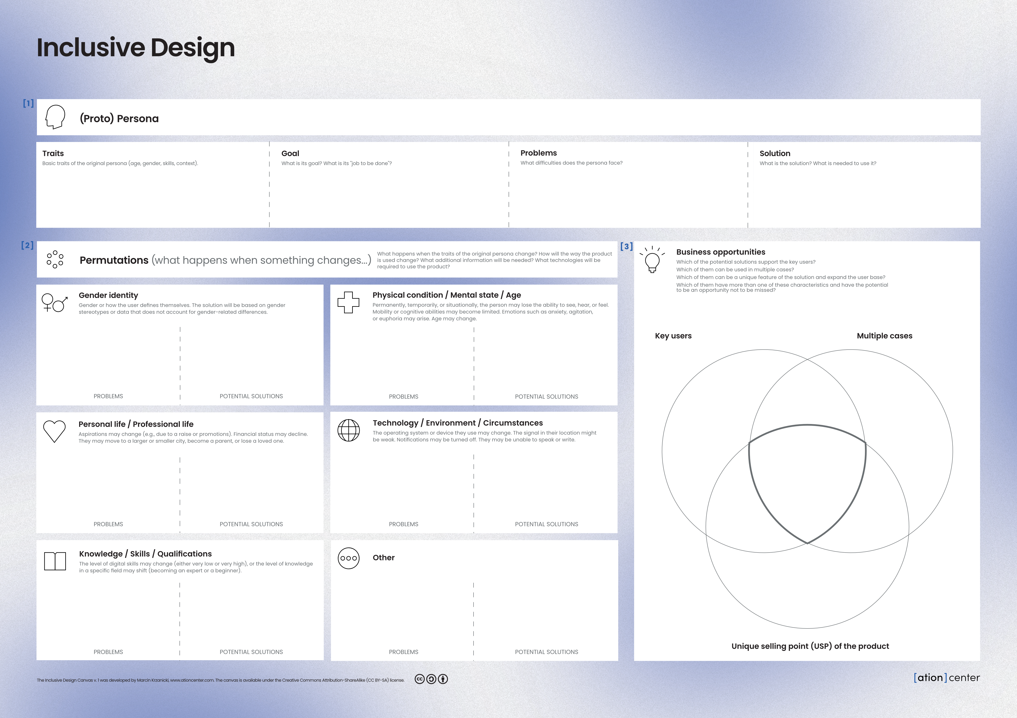
https://github.com/ka-er-zet/universal-design/blob/main/Inclusive_design_canvas.pdf

Slide 75
Work as a team

Slide 76
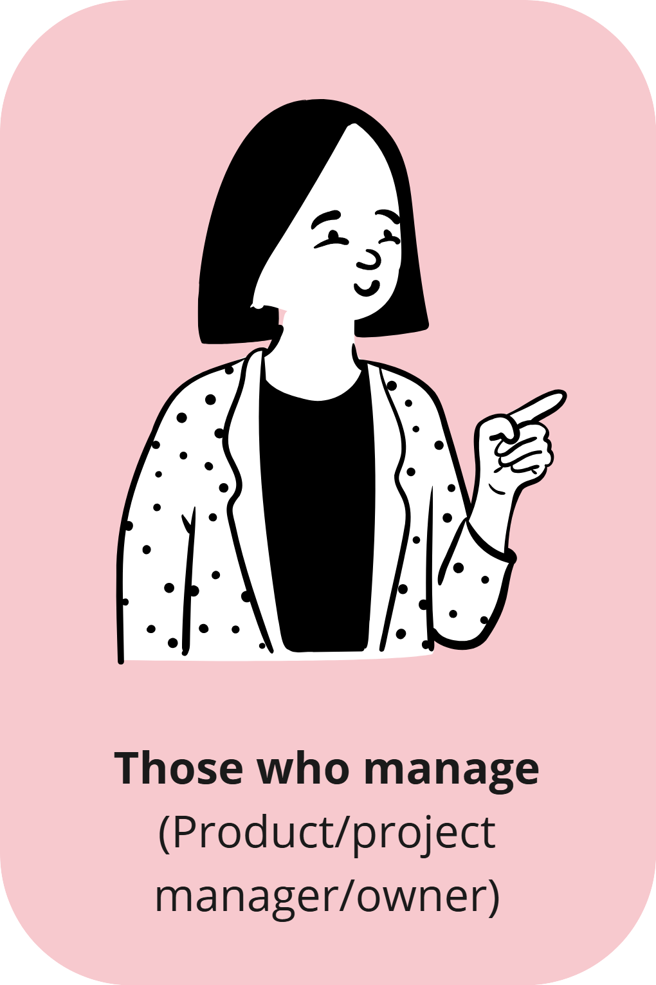
Allocate time for work related to inclusivity/accessibility/usability (research, testing, workshops).
Ensure the entire team has access to documents with accessibility requirements and best practices.
Focus on developing your knowledge in this area.
Introduce usability/accessibility testing as a standard in product testing and as an element of the definition of done.
Treat usability/accessibility-related bugs like any other product issues—assign them the same prioritization and ensure their resolution.
Create an accessibility stakeholder map for your product, incorporating an inclusive approach.
https://digital.gov/guides/accessibility-for-teams/

Slide 77
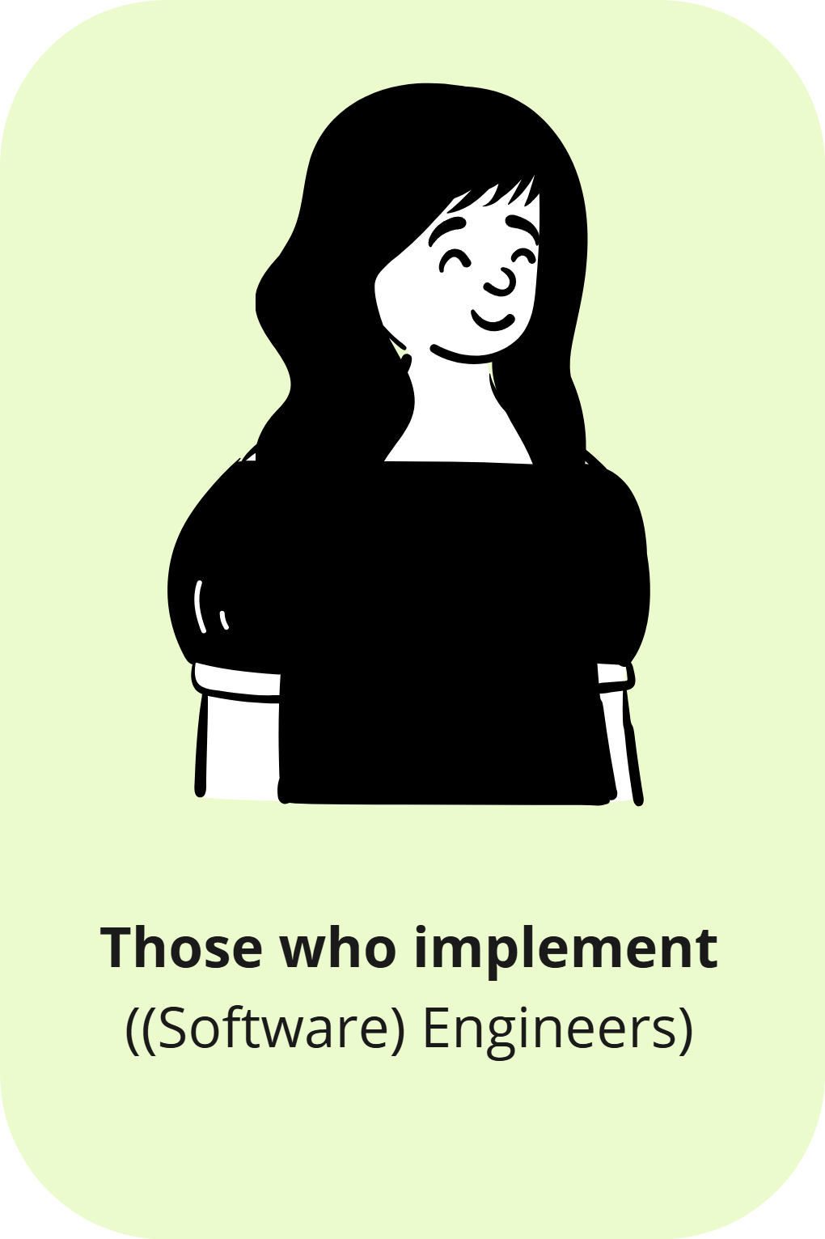
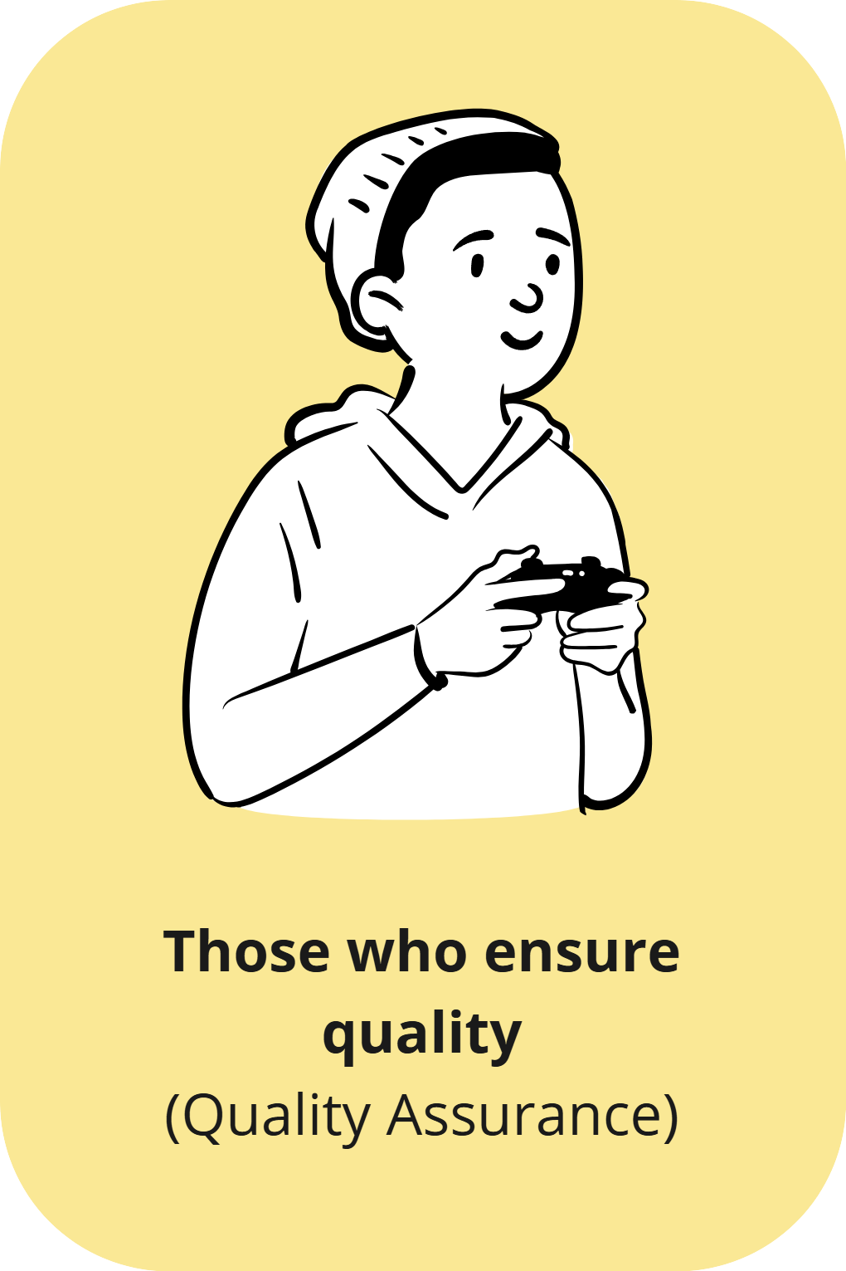
Follow the principles outlined in industrial standards and WCAG documents.
Ensure the correctness and cleanliness of the code.
Maintain constant communication with designers—pay attention to UI solutions that require excessive complexity in the code and may cause issues for alternative access methods (keyboard navigation/screen readers, etc.).
https://digital.gov/guides/accessibility-for-teams/

Slide 78
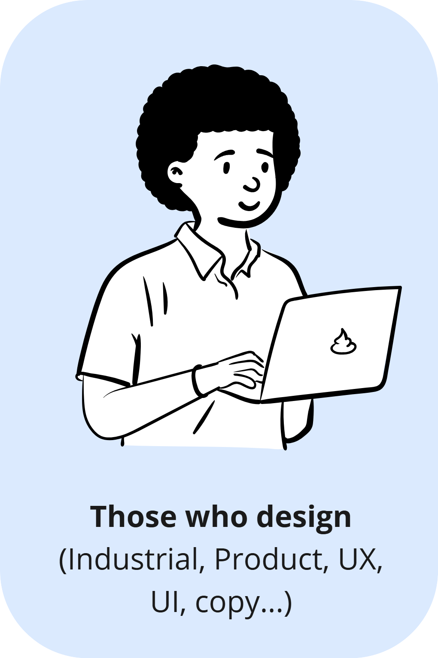
Focus on the overall experience (not just the website or application).
Use WCAG as the primary benchmark.
Ensure visual accessibility – contrast, colors, link highlights (not just by color).
Ensure links have contextually meaningful labels.
Create layouts that are visually comfortable to read.
Develop content that is easy to understand (plain language) and adapted to the cognitive abilities of users.
Maintain moderation in design (decorations, complex page layouts, animations…).
Use fonts that enhance readability (and limit the number of different fonts used).
Consistently apply graphic styles, highlights, icons, colors, interaction patterns, etc.
Ensure proper information architecture and navigation.
Avoid relying solely on icons to convey meaning.
https://digital.gov/guides/accessibility-for-teams/

Slide 79
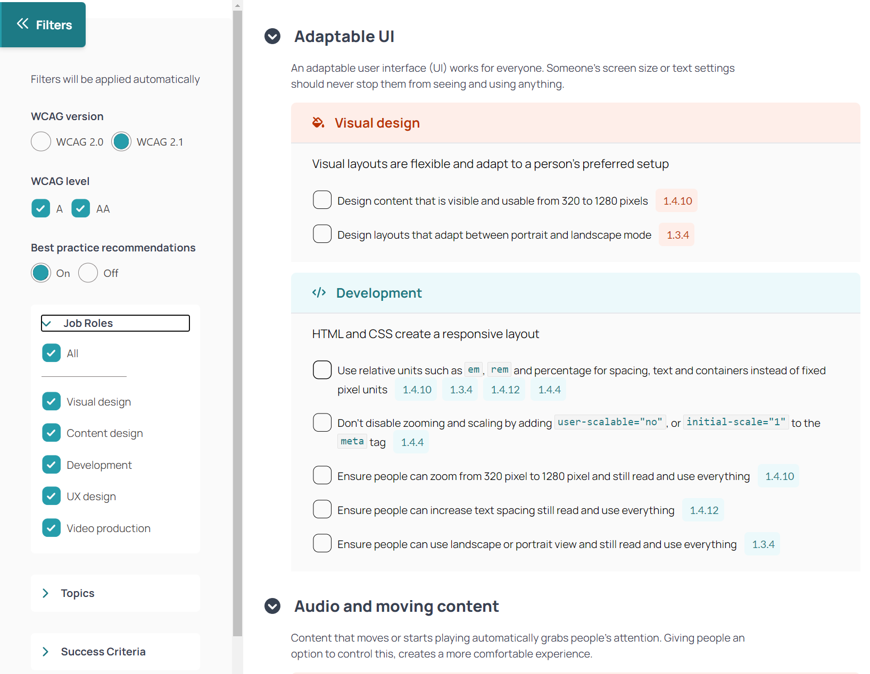
A tool for teams to support work with WCAG
Accessibility Not-Checklist: not-checklist.intopia.digital

Slide 80
Part 3
Case(s) for accessibility

Slide 81
So how many users have problems?

Slide 82
78%
Remember 78% people with mismatch?
According to the a research study conducted by Forrester Research for Microsoft in 2003

Slide 83

Permanent
Amputation of the hand
https://inclusive.microsoft.design/

Slide 84

Permanent
Amputation of the hand
Temporary
Sprained wrist
https://inclusive.microsoft.design/

Slide 85
Permanent
Amputation of the hand
Temporary
Sprained wrist
Situational
A parent holding a child
https://inclusive.microsoft.design/

Slide 86
Permanent
26K
Temporary
13M
Situational
8M
https://inclusive.microsoft.design/

Slide 87
Blindness
49.1 million
0.6% of the world's population
Visual impairments
255 million
3.2% of the world's population
"Global Prevalence of Blindness and Severe Visual Impairment from 1990 to 2020: Systematic Review and Meta-analysis", Investigative Ophthalmology & Visual Science (IOVS) journal.

Slide 88
Color vision impairments
300-350 million
3.8-4.4% of the world's population
Colorblind People Population! Statistics: https://www.colorblindguide.com/feed/page/3
Clinton Eye Center: https://clintoneye.com/services/color-blindness/

Slide 89

Deafness
70 million
0.9% of the world's population
Hearing impairments
1.5 bilion
18.8% of the world's population
Statistical data from WHO and the World Bank

Slide 90
For some people who are deaf from birth, auditory languages (e.g., Polish, English, etc.) along with their visual written forms, are foreign languages.
The native language is sign language (e.g., Polish Sign Language).This is an additional factor of exclusion.

Slide 91
Disabilities of the musculoskeletal system, mobility, and body structure
>1 bilion
12.5% of the world's population
Statistical data from WHO and the World Bank

Slide 92
Neurological and cognitive issues
(a total of 37 issues)
3.4 bilion
43% of the world's population
Global, regional, and national burden of disorders affecting the nervous system, 1990–2021: a systematic analysis for the Global Burden of Disease Study 2021 - The Lancet Neurology

Slide 93
Money

Slide 94
Income
Risk
Profit
The global purchasing power of people with permanent exclusions is 336 billion dollars
It is estimated that accessibility-conscious competition gains around 6.9 billion dollars annually (globally).
Improving the usability and accessibility of a product for an average of 20% of potential customers
In the United Kingdom alone, it amounts to 2 billion pounds per month
71% of customers with disabilities abandon inaccessible websites, and 48% of them make a purchase elsewhere
82% of customers experiencing exclusion would spend more if the website were more accessible
In the UK, inaccessible websites and apps lose 420 million pounds weekly due to this reason
Designing and implementing with accessibility in mind is cheaper than adding it later to a finished product.
Great CXcon for all, Inviqa

Slide 95
Maybe you have to…

Slide 96
45
At least 45 countries/regions have governmental policies related to web accessibility
https://www.w3.org/WAI/policies/

Slide 97
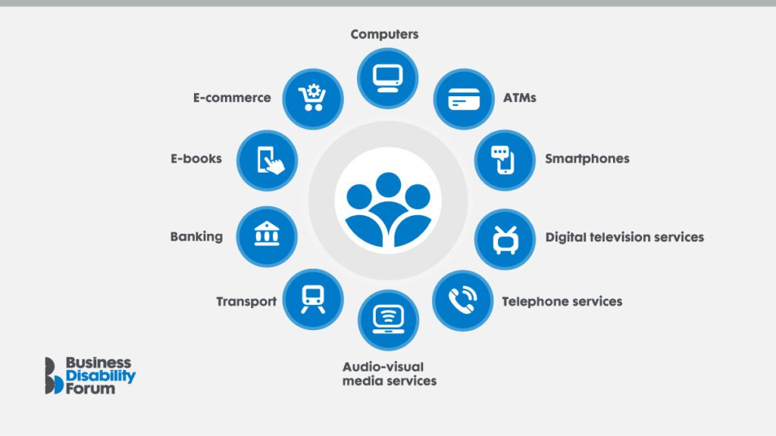
EU in 2025
European
Accessibility
Act
https://businessdisabilityforum.org.uk/resource/the-european-accessibility-act-eaa-what-businesses-need-to-know-and-do/

Slide 98
Future self

Slide 99
2x
We can count on new medications, assistive, and supportive solutions. But still, sooner or later, our body and mind will begin to work against us.
After reaching the age of 50, we enter a group where the likelihood of experiencing permanent disability doubles compared to the 40-49 age group.
https://www.w3.org/WAI/policies/

Slide 100
The end?

Slide 101
You are not the first one in this field

Slide 102
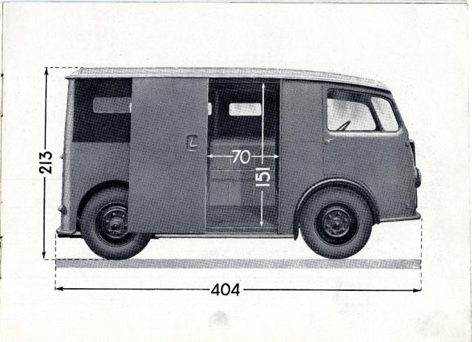
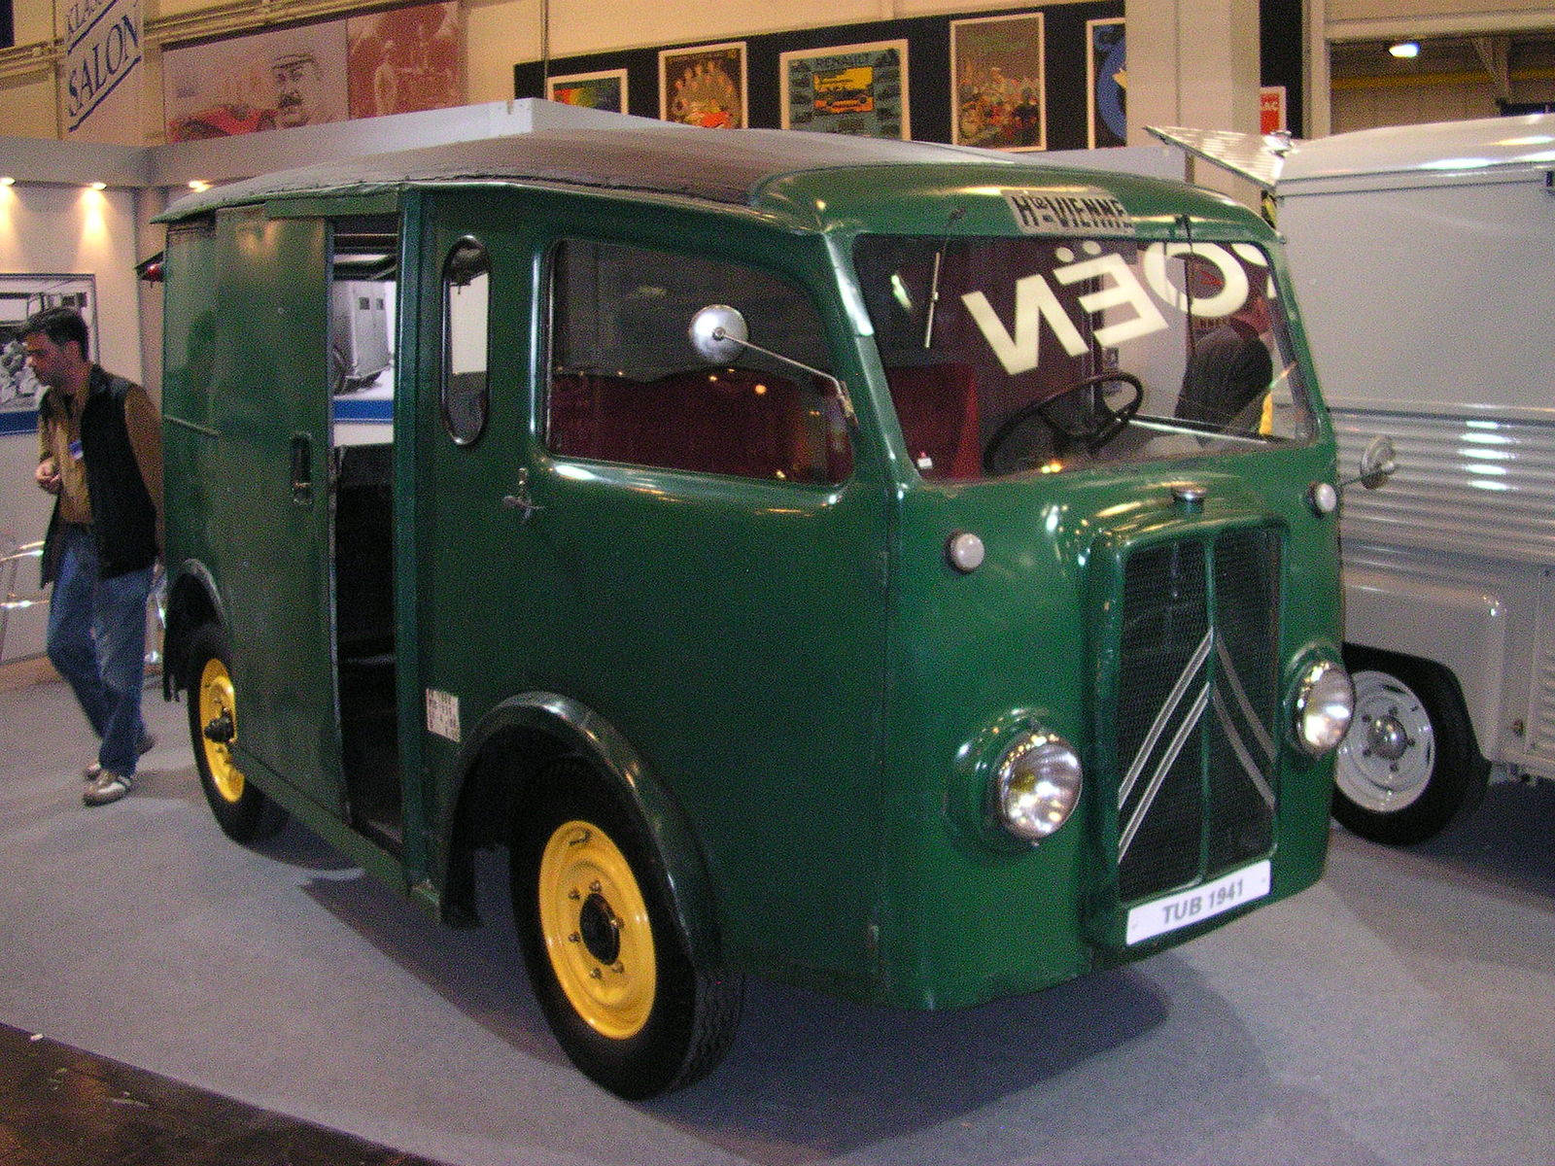
Citroen TUB/TUC - 1939/1941

Slide 103
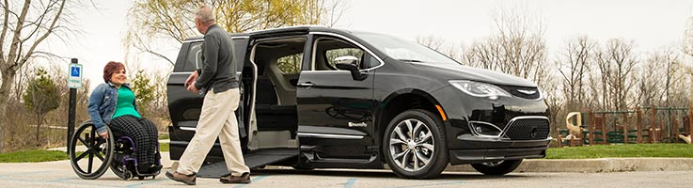


Slide 104

phonograph books, which will speak to blind people without effort on their part
One of the 10 uses listed by Edison in the patent application for the Tin-Foil Phonograph.

Slide 105



Slide 106


Slide 107
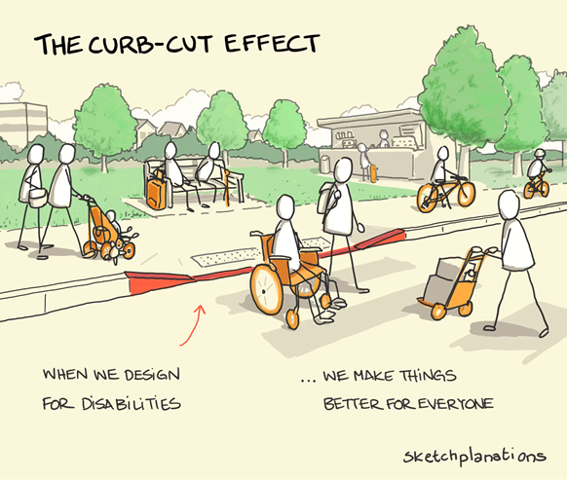
https://en.wikipedia.org/wiki/Curb_cut_effect
https://www.carleton.edu/accessibility-resources/newsletter/curb-cuts-a-brief-history/

Slide 108
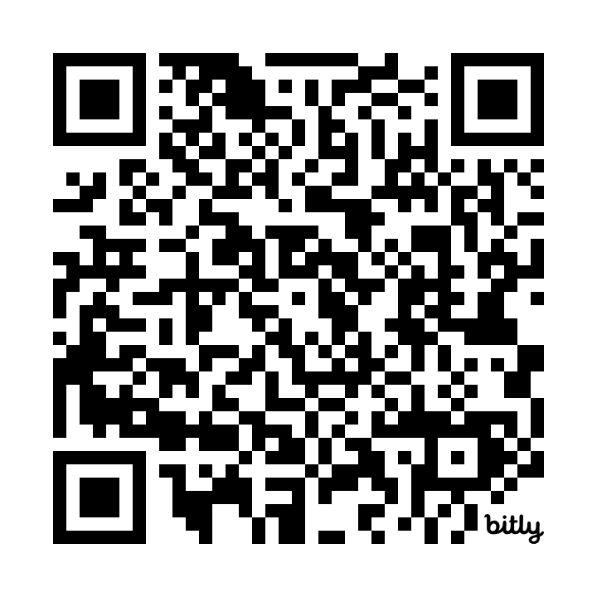
More...
https://bit.ly/year2025_accessibility

